Slide 1
TESTING AND AUTOMATION
SUBMITTED BY : SATYAM PUNIYA (RA1511008010409)

Slide 2
ABOUT THE COMPANY
MobiKwik is available for use at more than 2,50,000 online and offline avenues. Get kwik, hassle-free payments that are super-secure! The wallet app is used to browse the biggest online, retail and fashion stores.
MobiKwik is super-safe. Each and every penny stored in your wallet is well accounted for. You can also use the extra in-app security settings available on all mobile platforms MobiKwik is operational on. These are Android, Windows and iOS. All services of MobiKwik are also available via a desktop site and a mobile site.

Slide 3
MobiKwik received the coveted PrePaid Payment Instrument license from the Reserve Bank of India on 18 July, 2013.
BookMyShow, Café Coffee Day, Domino's Pizza, Sagar Ratna, Big Bazaar, Pizza Hut, TastyKhana, JustEat, PVR, eBay, Jabong, Snapdeal, Shopclues, HomeShop18, Naaptol, Pepperfry, Fashionara, FashionAndYou, MakeMyTrip, Ferns N Petals, are just some of the many brands associated with MobiKwik.

Slide 4
WHY USE MOBIKWIK:
Safe & Secure Payments: There is no need to share your valuable payment details at every other website you shop at. Just use MobiKwik to shop from anywhere you want.
Fastest Checkout: With the one-click process, MobiKwik has become the quickest checkout option when you are shopping online.
Multiple Payments: To store money once and make multiple transactions with MobiKwik.
Discounts & Offers: To get exclusive discounts & cashbacks at partner websites when you pay with your MobiKwik wallet.

Slide 5
OVERVIEW
MobiKwik launched an e-wallet system in 2012 that enabled users to deposit money online to use for bill payments and other features.In September 2014, Express Computer reported how MobiKwik was partnering with GoDaddy and other international companies to help them comply with Indian payment regulations.In June 2017, 80 percent of India's mobile wallet transactions market was performed by Paytm, ITZCash and Mobikwik.In March 2017, MobiKwik's largest competitor was Paytm.
In April 2015, MobiKwik was used by 15 million users and claimed to be adding one million new customers every month, according to Forbes India Magazine.In a partnership with CashCare, MobiKwik began providing small loans between 500–2,500 Indian rupees to customers in May 2016. In November 2016, MobiKwik had over 1.5 million merchants using its service and 55 million users.

Slide 6
TECHNICAL WORK / TRAINING
The focus of the training was on learning the fundamentals of Website Testing and Automation. In the training period, we were taught both the practical and conceptual skills that build the foundation for understanding basic Testing through software like Selenium,Postman etc. The starting phase of my training covered the following topics :

Slide 7
Postman
Basics of DBMS
MongoDB Basics
Advanced Java to access WebElements
Website Automation
WebDriver in java
Selenium in Java
Parsing Excel file in a java program
Selenium tool with Firefox
TestNG Framework
Dependencies in Maven

Slide 8
PROJECT OVERVIEW :
The conclusion phase of my training was more interesting and thrilling as I had to complete a project for the company in which I came to learn more in detail and depth about how it all works in a professional environment. I got to know how to access WebElements using Selenium Webridver in JAVA which included locating the WebElement and also assigning of WebDriver with the name or the xpath of the WebElement.

Slide 9
Test Automation
Test automation is the use of software
To set test preconditions.
To control the execution of tests.
To compare the actual outcomes to predicted outcomes.
To report the Execution Status.
Commonly, test automation involves automating a manual process already in place that uses a formalized testing process.

Slide 10
Selenium
Selenium is a robust set of tools that supports rapid development of test automation for web-based applications.
Selenium provides a rich set of testing functions specifically geared to the needs of testing of a web application.
Selenium operations are highly flexible, allowing many options for locating UI elements and comparing expected test results against actual application behavior.

Slide 11
Selenium Features
Supports Cross Browser Testing. The Selenium tests can be run on multiple browsers.
Allows scripting in several languages like Java, C#, PHP and Python.
Assertion statements provide an efficient way of comparing expected and actual results.
Inbuilt reporting mechanism.

Slide 12
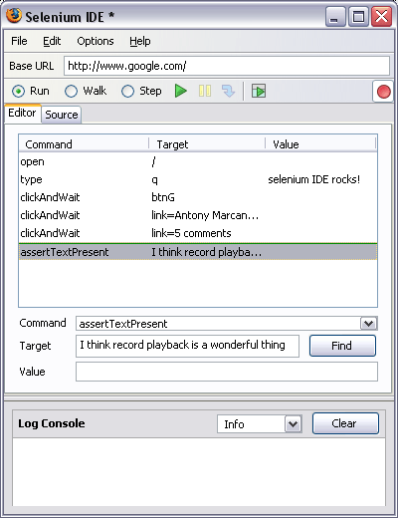
SELENIUM IDE USER INTERFACE :

Slide 13
General Selenium Commands :
clicking a link - click or clickAndWait commands
entering values - type command
selecting options from a drop-down listbox - select command
clicking checkboxes or radio buttons - click command

Slide 14
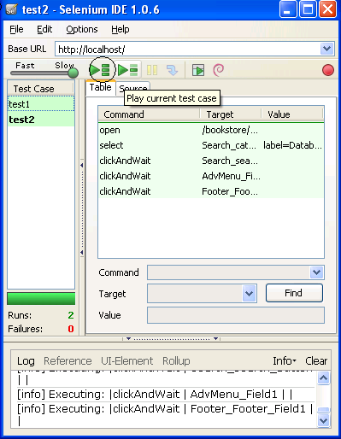
Creating a Test Suite :
In the Selenium IDE you can create any number of test cases and save them as test suite.
To Run the test Suite click on the “Play entire test suite” button as shown below.

Slide 15
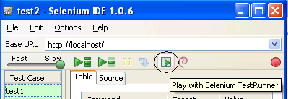
Playing The test Suite with Test Runner :
Test Runner allows you to run the test case in a browser loaded with the Selenium-Core TestRunner.
Test runner is invoked by clicking the below Shown button in the IDE
On Clicking the Test Runner Button you will the window as seen in the next slide.

Slide 16
Assertions :
Assertions are same as Verifications. The only difference is, if the assertions fail the script will abort. But the script will continue run in case a verification point fails.
The steps for inserting the assertions is same as that of verification point.
While recording Right Click → Show all commands → select an assertion.

Slide 17
Running a Selenium Test on Different Browsers :
Record a test case using selenium IDE and save it as “Test1.html” (say).
Record another test case using selenium IDE and save its as “Test3.html” (say).
In this way you can record any number of test case using selenium IDE and save them as <filename>.html
Then Create a New Test Suite using the File Menu. See the Image Below.

Slide 18
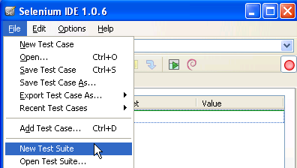

Slide 19
Selenium Test Case Development Using Java :
Required Software :
Selenium RC Server jar , Selenium Java Client Driver jar , JDK 1.6 +, Eclipse (or any other IDE), Junit jar and testng jar.
For building the frame work we require continuous build integration tools like Ant, Maven or cruise control.

Slide 20
FINAL PROJECT :
In my final project I was told to automate the MobiKwik Hotels website as I was a part of the Hotels team. I had to make a program in java that would automate the whole website using Selenium WebDriver which could be firefoxdriver or chromedriver. I personally learnt a lot about automation , which includes how to inspect any WebElement and find out its Xpath or a designated id by which the WebElement could be easily found out.
I was personally guided by Mr.Saarthak Vats (Product Manager) OneMobiKwik Solutions Pvt Ltd. The overall experience of sitting and working in an office was absolutely fantastic. I met some wonderful people there many of which usually guided me so I can thrive in my future.
It was an experience of a lifetime and I would personally thank everybody who was a part of it.I will never forget an experience like this.

Slide 21
THE GOOGLE DRIVE LINK FOR THE PROJECT :
https://drive.google.com/open?id=0B-TWUQxHtZiqODB1S1FZNEREUzA

Slide 22
CONCLUSION
The course was mainly for software testing professionals and anyone who is interested in planning and performing web application performance tests. The main goal of the training program was to define the process, tools, issues and challenges for the performance testing in a variety of web environments. The course has two levels. Fundamental Level, which addresses for professionals requiring to have a basic understanding of performance testing. However, they can further move on to Advance Level in order to learn the in-depth knowledge.

Slide 23
Training Objective
The following were the traits that were taught and accomplished in the entire training period:
Examine performance requirements and ensure that the requirements are realistic and achievable.
Specify what types of performance tests are required and create tests, test cases and test scripts.
Communicate adequately with appropriate technical personnel to ensure that the correct test environments are set up
Understand the capabilities of performance testing tools and make a significant contribution to tool selection.
Execute performance tests and analyze the results
Make a contribution to diagnosing performance problems.
Understand how to test a site’s reliability and scalability prior to release.

